Slide 1
Introduction to Cursors
Chapter 5

Slide 2
Objectives
Use a simple loop to fetch multiple rows from a cursor
Create PL/SQL code that successfully closes a cursor after fetching data into a variable
Define a record structure for a cursor using the %ROWTYPE attribute
Create PL/SQL code to process the rows of an active set using record types in cursors
Retrieve information about the state of an explicit cursor using cursor attributes

Slide 3
Context Areas and Cursors
The Oracle server allocates a private memory area called a context area to store the data processed by a SQL statement
Every context area (and therefore every SQL statement) has a cursor associated with it
A cursor is a context area, or as a pointer to the context area

Slide 4
Implicit and Explicit Cursors
There are two types of cursors:
Implicit cursors: Defined automatically by Oracle for all SQL DML statements (INSERT, UPDATE, DELETE, and MERGE), and for SELECT statements that return only one row
Explicit cursors: Declared by the programmer for queries that return more than one row. You can use explicit cursors to name a context area and access its stored data

Slide 5
CURSOR
Implicit
Explicit
Automatically created by oracle
User can’t control the behavior of these cursor
User defined Cursor
Return more than one row and user has full control

Slide 6
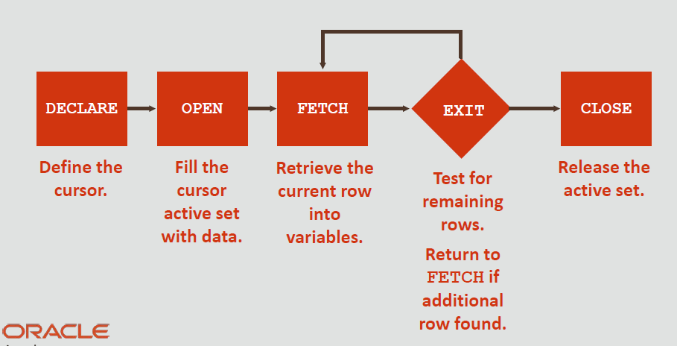
Steps for Using Explicit Cursors
You first DECLARE a cursor, and then you use the OPEN, FETCH, and CLOSE statements to control a cursor.

Slide 7
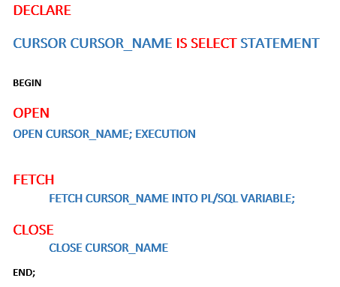
Explicit Cursors Syntax
You can declare variables as well
IS PL/SQL Identifier.
IS a SELECT statement without an INTO clause.

Slide 8
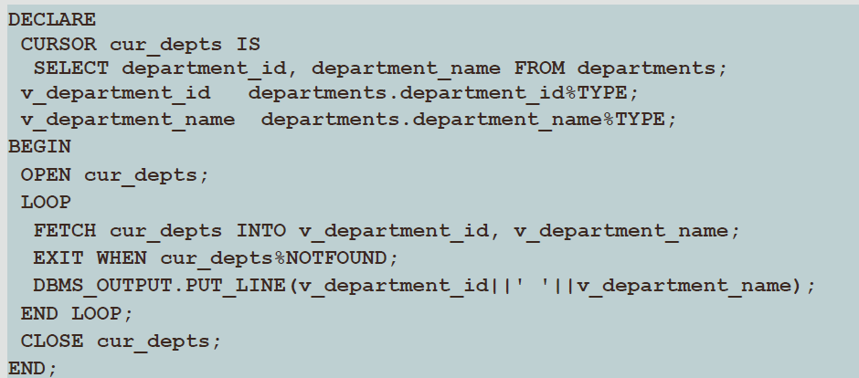
Example 1: of an Explicit Cursor

Slide 9
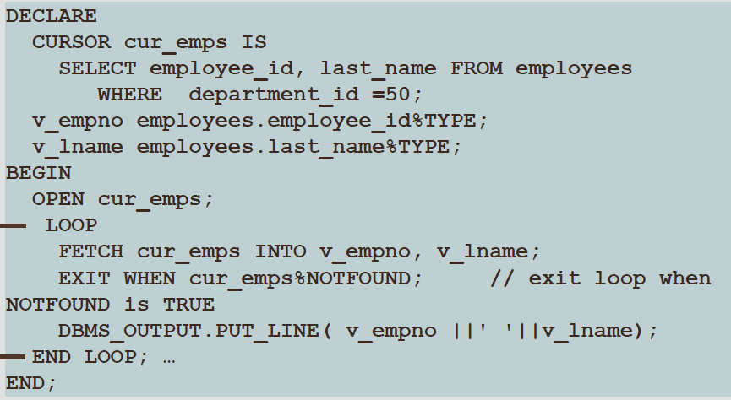
Example 2 of an Explicit Cursor

Slide 10
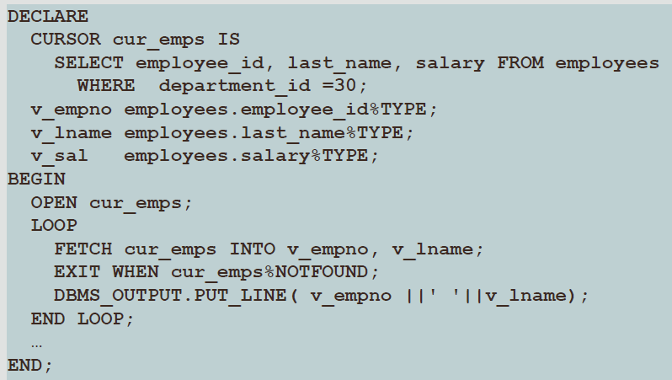
Fetching Data From the Cursor Example 1
What is wrong with this example?

Slide 11
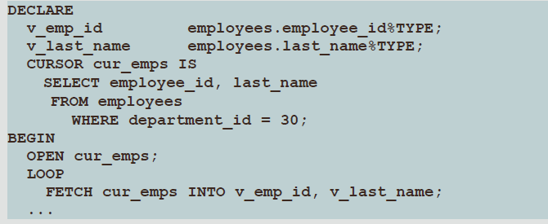
Cursors and Records
The cursor in this example is based on a SELECT statement that retrieves only two columns of each table row
What if it retrieved six columns...or ten, or twenty?

Slide 12
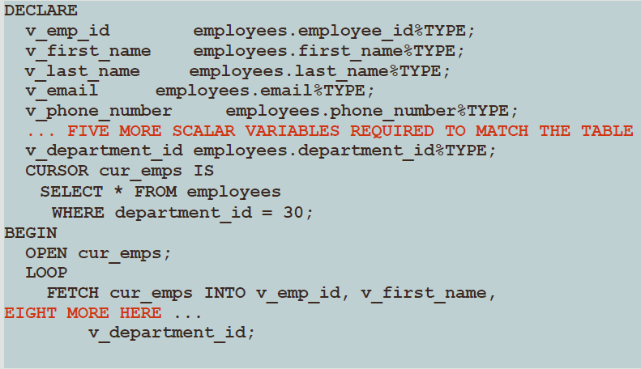
This cursor retrieves whole rows of EMPLOYEES Imagine the list of declarations with all columns listed

Slide 13
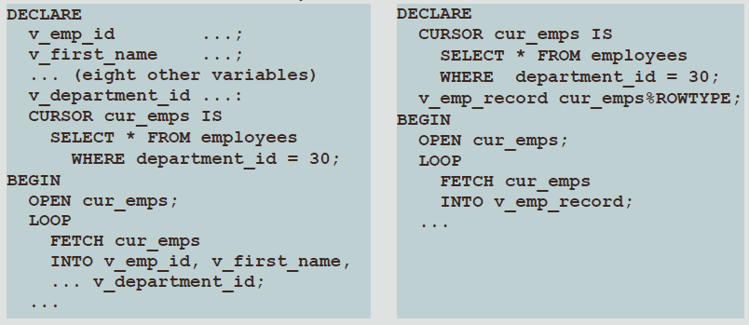
Cursors and Records
Compare the following snippets of code
What differences do you see?

Slide 14
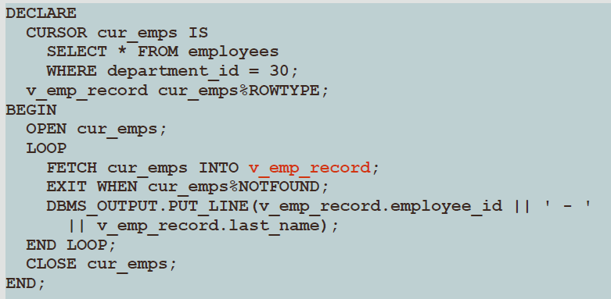
Cursors and %ROWTYPE
The code on the left uses %ROWTYPE to declare a record structure based on the cursor
A record is a composite data type available in PL/SQL
V_EMP_RECORD will include all of the columns found in the EMPLOYEES table

Slide 15
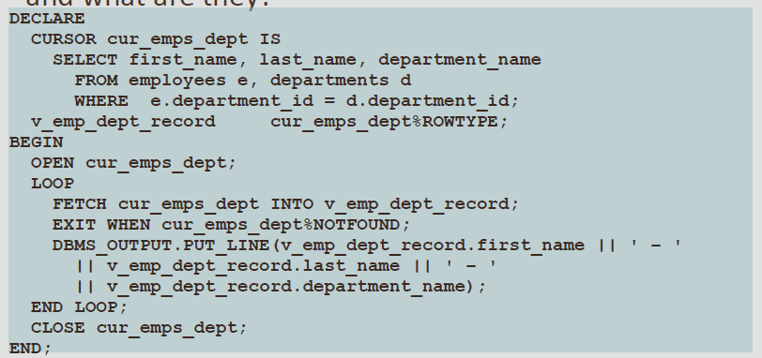
Cursors and %ROWTYPE: Another Example

Slide 16
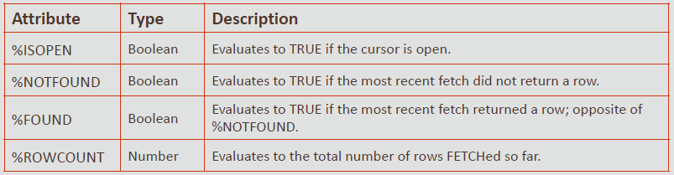
Explicit Cursor Attributes
As with implicit cursors, there are several attributes for obtaining status information about an explicit cursor
When appended to the cursor variable name, these attributes return useful information about the execution of a cursor manipulation statement

Slide 17
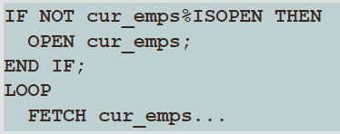
%ISOPEN Attribute
You can fetch rows only when the cursor is open
Use the %ISOPEN cursor attribute before performing a fetch to test whether the cursor is open
%ISOPEN returns the status of the cursor: TRUE if open and FALSE if not
Example:

Slide 18
%ROWCOUNT and %NOTFOUND Attributes
Usually the %ROWCOUNT and %NOTFOUND attributes are used in a loop to determine when to exit the loop
Use the %ROWCOUNT cursor attribute for the following:
To process an exact number of rows
To count the number of rows fetched so far in a loop and/or determine when to exit the loop
Use the %NOTFOUND cursor attribute for the following:
To determine whether the query found any rows matching your criteria
To determine when to exit the loop

Slide 19
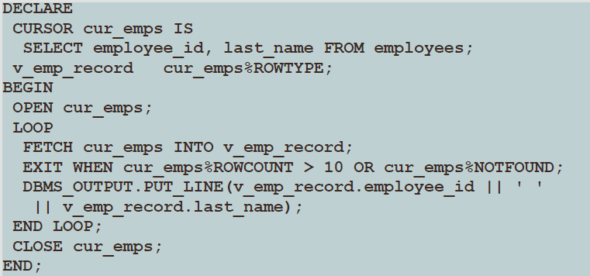
Example of %ROWCOUNT and %NOTFOUND

Slide 20
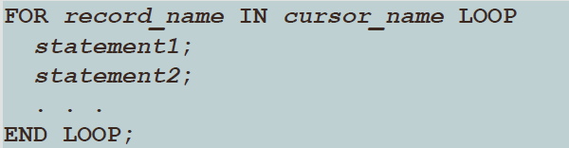
Cursor FOR Loops
A cursor FOR loop processes rows in an explicit cursor
It is a shortcut because the cursor is opened, a row is fetched once for each iteration in the loop, the loop exits when the last row is processed, and the cursor is closed automatically
Syntax:

Slide 21
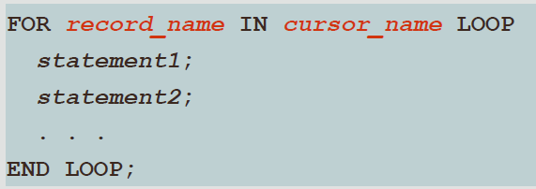
Cursor FOR Loops
In the syntax:
record_name Is the name of the implicitly declared record(as cursor_name%ROWTYPE)
cursor_name Is a PL/SQL identifier for a previously declared cursor

Slide 22
Cursor FOR Loops
You can simplify your coding by using a cursor FOR loop instead of the OPEN, FETCH, and CLOSE statements
A cursor FOR loop implicitly declares its loop counter as a record that represents a row FETCHed from the database
A cursor FOR loop:
OPENs a cursor
Repeatedly FETCHes rows of values from the active set into fields in the record
CLOSEs the cursor when all rows have been processed

Slide 23
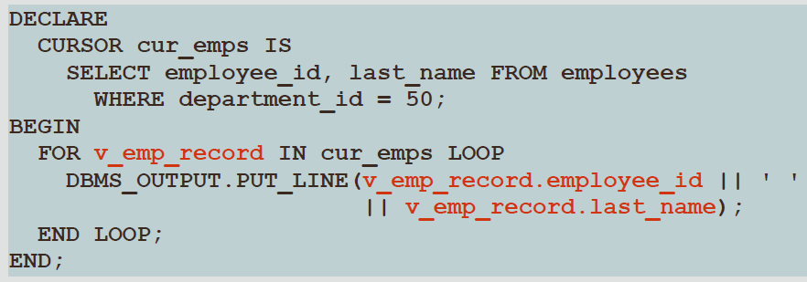
Cursor FOR Loops
No variables are declared to hold the fetched data and no INTO clause is required
OPEN and CLOSE statements are not required, they happen automatically in this syntax

Slide 24
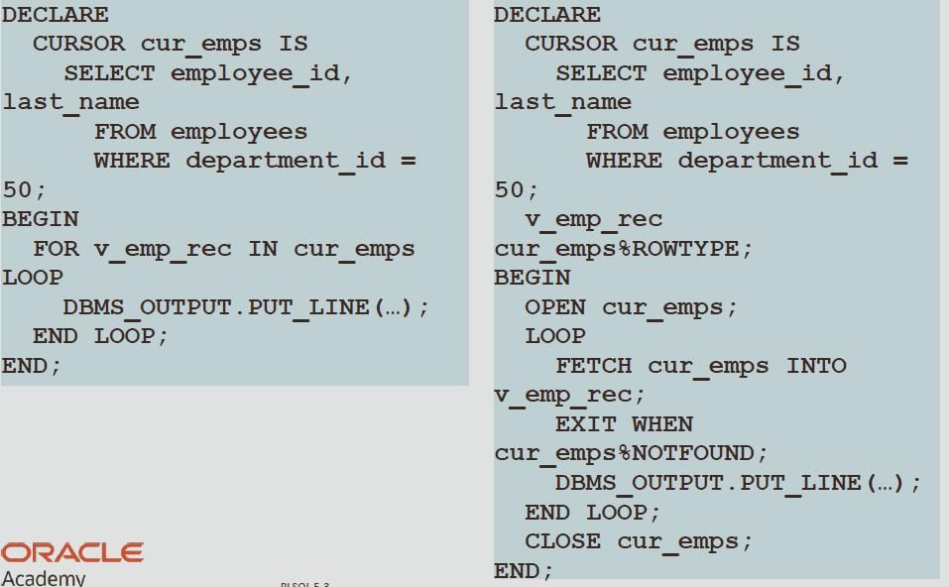
Cursor FOR Loops

Slide 25
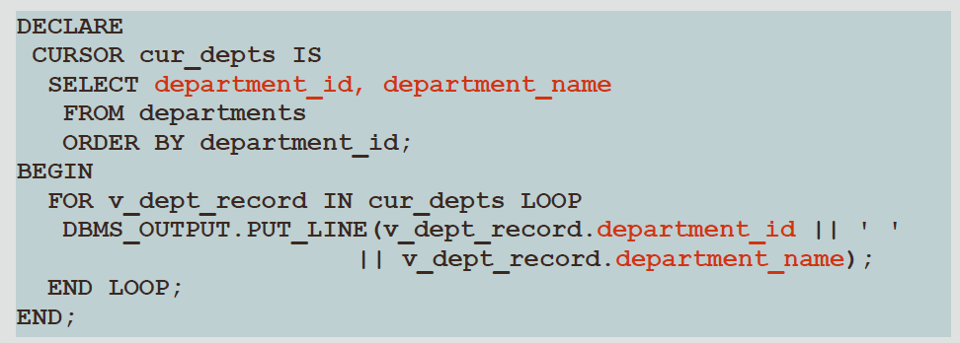
Cursor FOR Loops: A Second Example
v_dept_record has been implicitly declared as cur_depts%ROWTYPE
How many fields does it contain?

Slide 26
Cursors with Parameters
A parameter is a variable whose name is used in a cursor declaration
When the cursor is opened, the parameter value is passed to the Oracle server, which uses it to decide which rows to retrieve into the active set of the cursor
This means that you can open and close an explicit cursor several times in a block, or in different executions of the same block, returning a different active set on each occasion

Slide 27

Defining Cursors with Parameters Syntax
Each parameter named in the cursor declaration must have a corresponding value in the OPEN statement
Parameter data types are the same as those for scalar variables, but you do not give them sizes
The parameter names are used in the WHERE clause of the cursor SELECT statement

Slide 28

Defining Cursors with Parameters Syntax
In the syntax:
cursor_name Is a PL/SQL identifier for the declared cursor
parameter_name Is the name of a parameter
datatype Is the scalar data type of the parameter
select_statement Is a SELECT statement without the INTO clause

Slide 29
Opening Cursors with Parameters
The following is the syntax for opening a cursor with parameters:
You pass parameter values to a cursor when the cursor is opened
Therefore you can open a single explicit cursor several times and fetch a different active set each time
In the following example, a cursor is opened several times

Slide 30
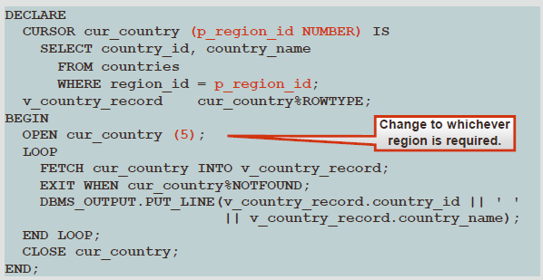
Cursors with Parameters: Example

Slide 31
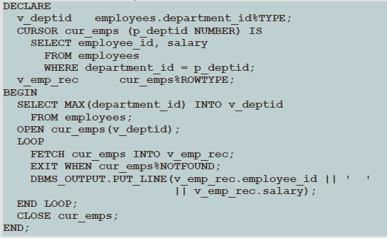
Another Example of a Cursor with a Parameter

Slide 32
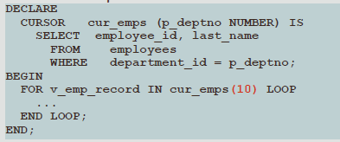
Cursor FOR Loops wıth a Parameter
We can use a cursor FOR loop if needed:
Parameters are placed inside parentheses following the CURSOR
FOR…END LOOP statements let you execute a sequence of statements multiple times
The CURSOR will repeatedly use new value(s) that are passed into the parameter

Slide 33
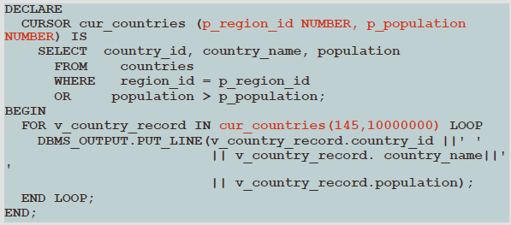
Cursors with Multiple Parameters: Example 1
In the following example, a cursor is declared and is called with two parameters:

Slide 34
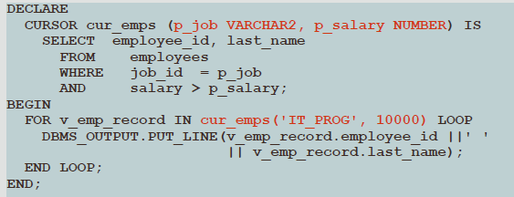
Cursors with Multiple Parameters: Example2
This cursor fetches all IT Programmers who earn more than $10000

Slide 35
Using Cursors for Update
If multiple users are connected to the database at the same time, the possibility exists that another user updated the rows of a particular table after you opened your cursor and fetched the rows
We can lock rows as we open the cursor in order to prevent other users from updating them–this is important especially if we are going to do updates ourselves
An open cursor provides a read-consistent view of the data fetched by the cursor
This means that any updates made by other users since the cursor was opened will not be seen when we fetch the rows, even if the updates were committed
Our session would have to close and re-open the cursor in order to see the committed updates

Slide 36

Declaring a Cursor with the FOR UPDATE Syntax
When we declare a cursor FOR UPDATE, each row is locked as we open the cursor
This prevents other users from modifying the rows while our cursor is open
It also allows us to modify the rows ourselves using a … WHERE CURRENT OF … clause
This does not prevent other users from reading the rows

Slide 37

Declaring a Cursor with the FOR UPDATE Clause
column_reference is a column in the table whose rows we need to lock
If the rows have already been locked by another session:
NOWAIT returns an Oracle server error immediately
WAIT n waits for n seconds, and returns an Oracle server error if the other session is still locking the rows at the end of that time

Slide 38
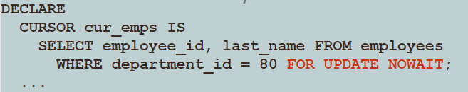
NOWAIT Keyword in the FOR UPDATE Clause Example
The optional NOWAIT keyword tells the Oracle server not to wait if any of the requested rows have already been locked by another user
Control is immediately returned to your program so that it can do other work before trying again to acquire the lock
If you omit the NOWAIT keyword, then the Oracle server waits indefinitely until the rows are available

Slide 39
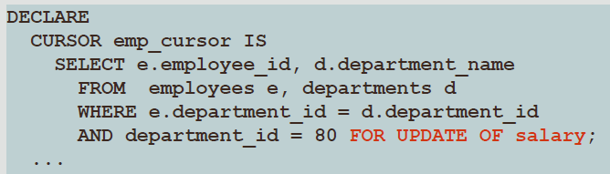
FOR UPDATE OF column-name Example
If the cursor is based on a join of two tables, we may want to lock the rows of one table but not the other
To do this, we specify any column of the table we want to lock

Slide 40
WHERE CURRENT OF Clause Syntax
The WHERE CURRENT OF clause is used in conjunction with the FOR UPDATE clause to refer to the current row (the most recently FETCHed row)in an explicit cursor
The WHERE CURRENT OF clause is used in the UPDATE or DELETE statement, whereas the FOR UPDATE clause is specified in the cursor declaration
cursor_name Is the name of a declared cursor (The cursor must have been declared with the FOR UPDATE clause)

Slide 41

WHERE CURRENT OF Clause Syntax
You can use WHERE CURRENT OF for updating or deleting the current row from the corresponding database table
This enables you to apply updates and deletes to the row currently being addressed, without the need to use a WHERE clause
You must include the FOR UPDATE clause in the cursor query so that the rows are locked on OPEN

Slide 42

WHERE CURRENT OF Clause Example
Use cursors to update or delete the current row
Include the FOR UPDATE clause in the cursor query to lock the rows first
Use the WHERE CURRENT OF clause to reference the current row from an explicit cursor

Slide 43
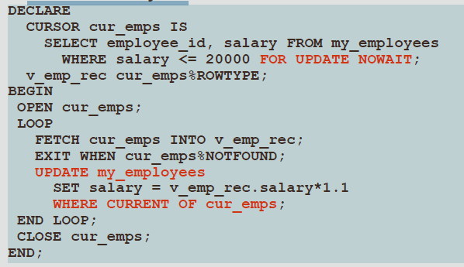
NOWAIT, FOR UPDATE, and WHERE CURRENT OF Clause
In this example, we don’t need a column-reference in the FOR UPDATE

Slide 44
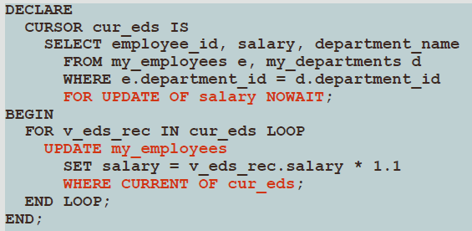
FOR UPDATE Second Example
FOR UPDATE OF salary locks only the MY_EMPLOYEES rows, not the MY_DEPARTMENTS rows
Note that we update the table-name, not the cursor-name!

